Slide 1
IBM HACKATHON
Problem statement 2
Team Members :
Harshada Yesane
Sudhanshu Bhoi
Vineet Tambe

Slide 2
Table of Content
Overview
Problem Statement
Team Members
Technologies/API used
Architecture diagram
DFD’s/ Flow diagrams

Slide 3
Overview
Stack Overflow is a question and answer site for professional and enthusiast programmers. It's built and run by the community of developer, as part of the Stack Exchange network of Q&A sites.
A lot of content is present in form of stack overflow questions and answers, various studies point that developers face problems while development life cycles and they ask questions on stack overflow which gets answered by fellow developers across the globe.
In order for a new developer to understand a concept or solve an issue, it is very difficult to identify the problems. It involves domain experts in form of experienced software developers. The information present is overwhelming and at times can be too much to handle for a budding developer.

Slide 4
Problem Statement
Identification of User Query on Stack Overflow Using Semantic
Problem Description:
To identify most relevant questions to a query [text similarity]
Identify the matching tags and pick top relevant questions from stack overflow.
To identify top k solutions of the problem.(sentiment analysis of review content)

Slide 5
Technologies/API used
Packages :
stackapi
Twython
Modules:
Regular Expression
Nltk
sklearn

Slide 6
NLTK
It contains text processing libraries for tokenization, parsing, classification, stemming, tagging and semantic reasoning.
Here we have imported different modules from nltk for respective work.
StackAPI
StackAPI is a simple Python wrapper for the Stack Exchange API .Retrieve multiple pages of results with a single call and merge all the results into a single response.

Slide 7
Different Modules of NLTK:
SentimentIntensityAnalyzer:
VADER Sentiment Analysis. VADER (Valence Aware Dictionary and sEntiment Reasoner) is a lexicon and rule-based sentiment analysis tool that is specifically attuned to sentiments expressed in social media, and works well on texts from other domains.I t calculates positive/negative value for each word.
2. Stopwords:
One of the major forms of pre-processing is to filter out useless data. In natural language processing, useless words (data), are referred to as stop words.We would not want these words taking up space in our database, or taking up valuable processing time. For this, we can remove them easily, by storing a list of words that you consider to be stop words.

Slide 8
3.Wordnet:
Wordnet is a lexical database for the English language and is part of the NLTK corpus. You can use WordNet alongside the NLTK module to find the meanings of words, synonyms, antonyms, and more.
4.WordNetLemmatizer:
Lemmatization usually refers to doing things properly with the use of a vocabulary and morphological analysis of words, normally aiming to remove inflectional endings only and to return the base or dictionary form of a word, which is known as the lemma .
5.Stemming:
Stemming and Lemmatization both generate the root form of the inflected words. The difference is that stem might not be an actual word whereas, lemma is an actual language word.

Slide 9
Sklearn features:
1.CountVectorizer:
The CountVectorizer provides a simple way to both tokenize a collection of text documents and build a vocabulary of known words, but also to encode new documents using that vocabulary.CountVectorizer can lowercase letters, disregard punctuation and stopwords, but it can't LEMMATIZE or STEM
2.TfidfVectorizer:
The goal of using tf-idf is to scale down the impact of tokens that occur very frequently in a given corpus and that are hence empirically less informative than features that occur in a small fraction of the training corpus.

Slide 10
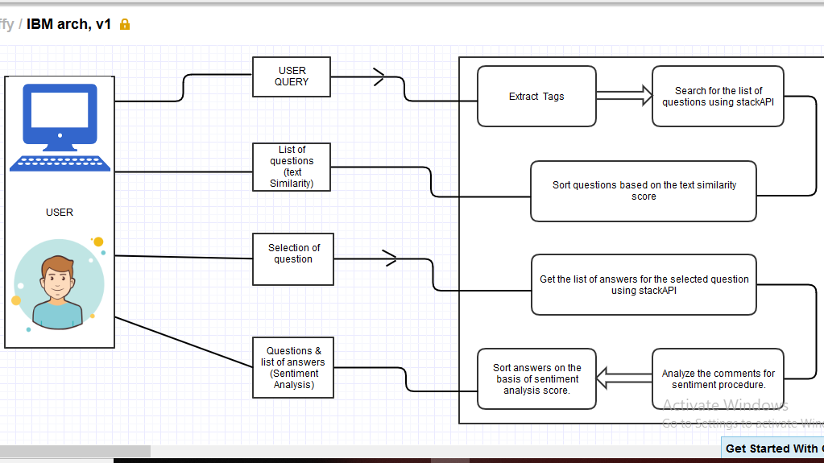
WEBSITE(STACKOVERFLOW)

Slide 11
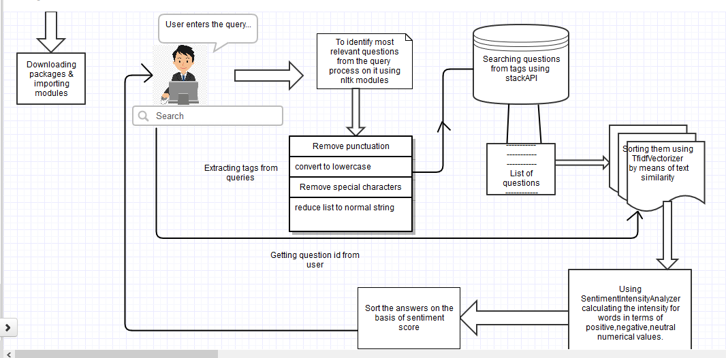
FLOW DIAGRAM

Slide 12

Thank you!

